Slide 1
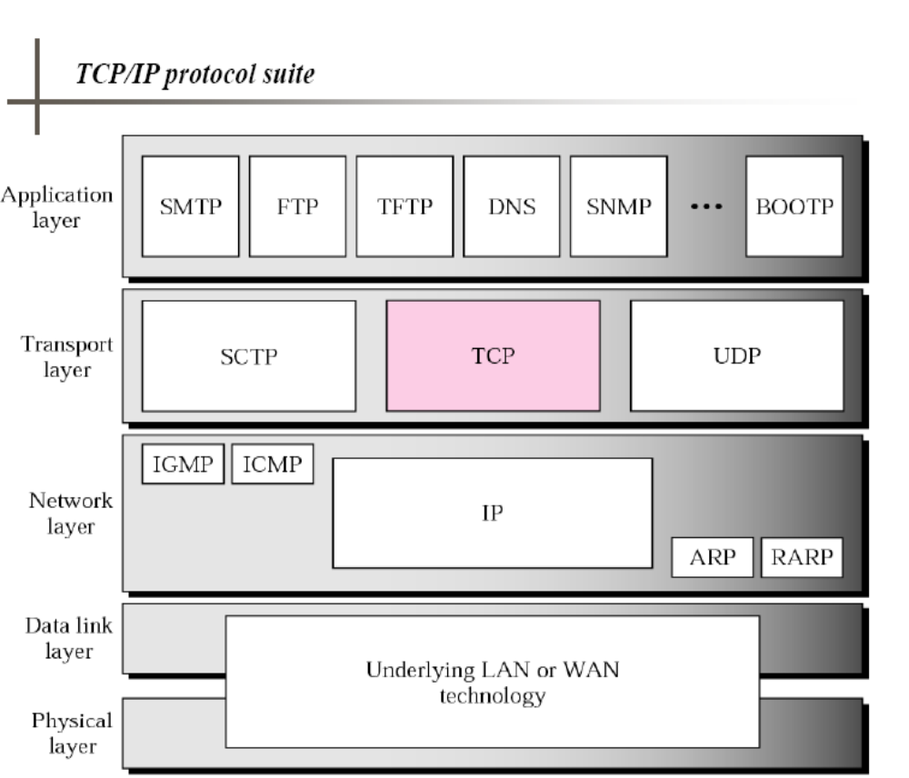

Slide 2
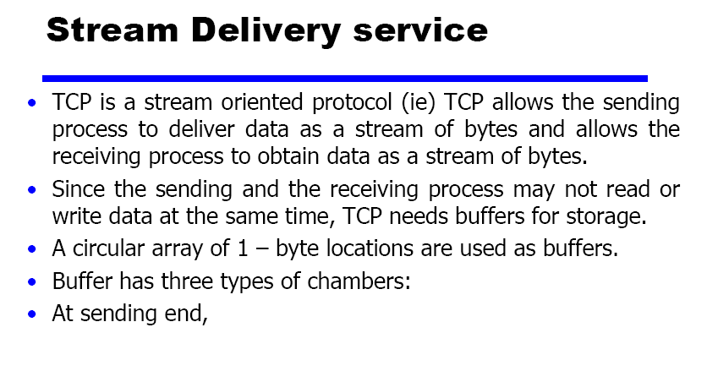

Slide 3
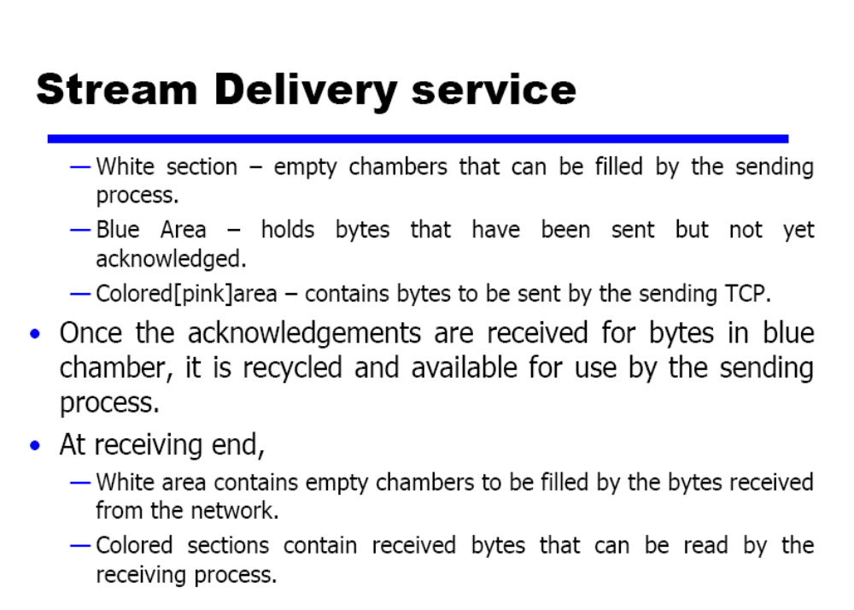

Slide 4
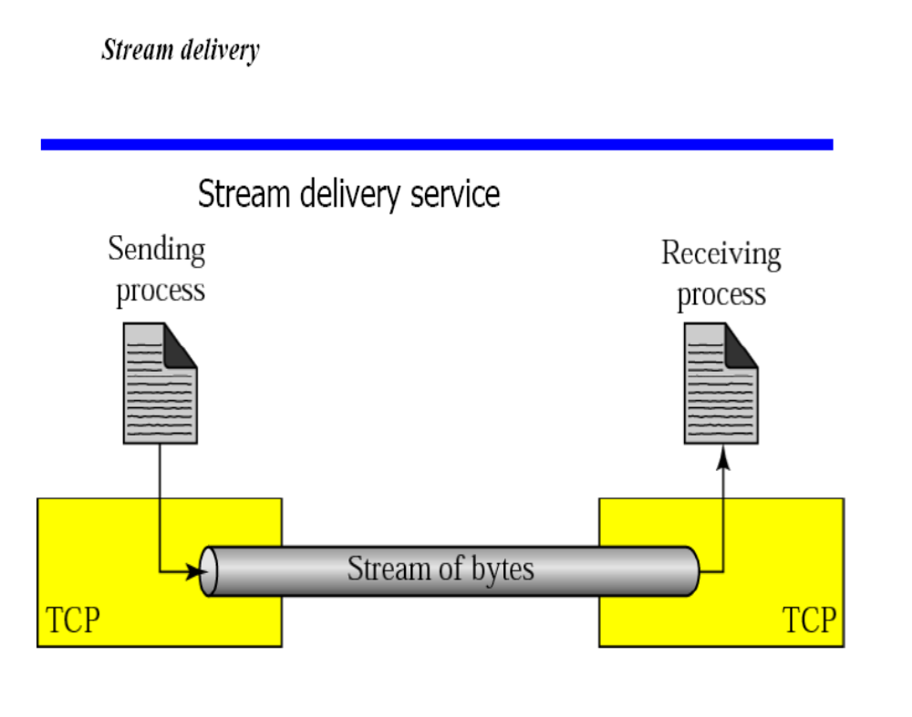

Slide 5
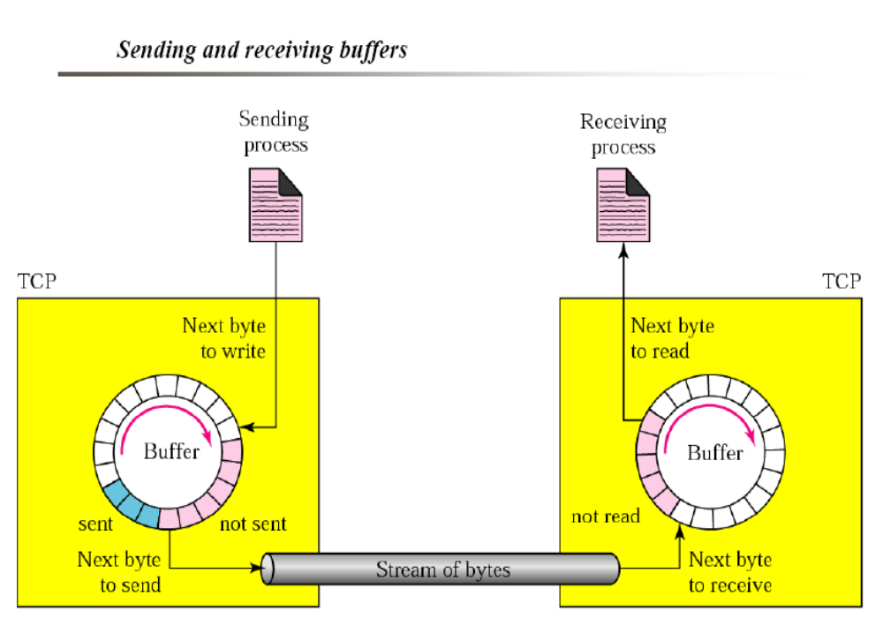

Slide 6
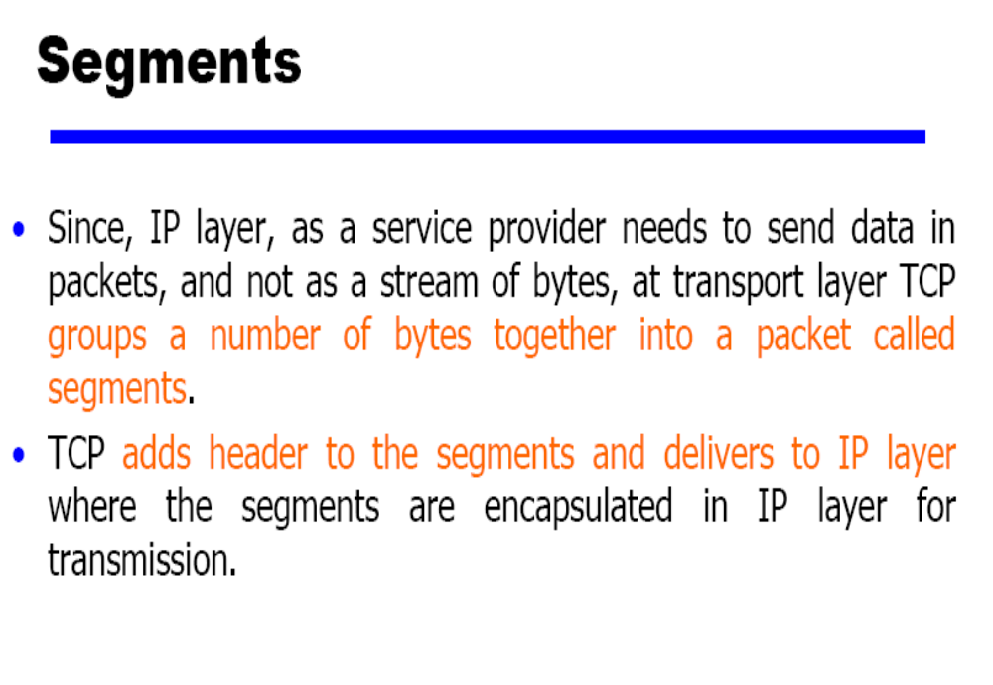

Slide 7
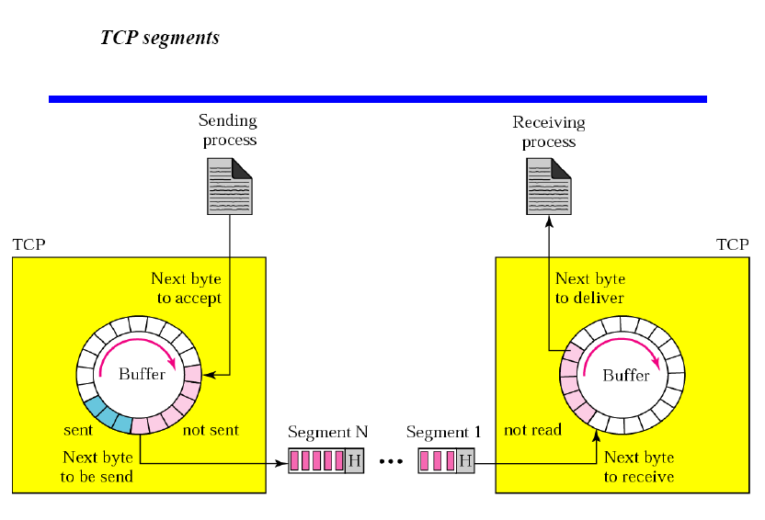

Slide 8
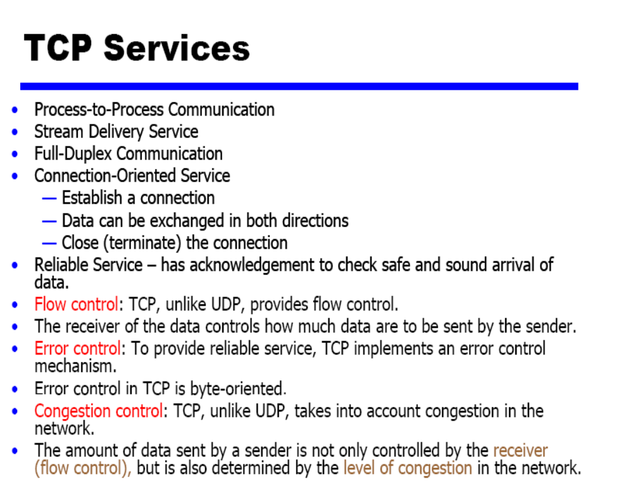

Slide 9
TCP
Reliable byte-stream service
More complex transmitter & receiver
  Connection-oriented: full-duplex unicast connection between client & server processes
  Connection setup, connection state, connection release
  Higher header overhead
  Error control, flow control, and congestion control
  Higher delay than UDP
Most applications use TCP
  HTTP, SMTP, FTP, TELNET, POP3, …

Slide 10
Reliable Byte-Stream Service
Stream Data Transfer
  transfers a contiguous stream of bytes across the network, with no indication of boundaries
  groups bytes into segments
  transmits segments as convenient (Push function defined)
Reliability
  error control mechanism to deal with IP transfer impairments
Write 45 bytes
Write 15 bytes
Write 20 bytes
Application
Read 40 bytes
Read 40 bytes
Transport
segments
Error Detection & Retransmission
buffer
buffer
ACKS, sequence #

Slide 11
Flow Control
Buffer limitations & speed mismatch can result in loss of data that arrives at destination
Receiver controls rate at which sender transmits to prevent buffer overflow
Application
Transport
segments
buffer used
buffer
advertised
window size < B
buffer available = B

Slide 12
TCP Multiplexing
A TCP connection is specified by a 4-tuple
  (source IP address, source port, destination IP address, destination port)
TCP allows multiplexing of multiple connections between end systems to support multiple applications simultaneously
Arriving segment directed according to connection 4-tuple
1
2
...
m
1
2
...
n
1
2
...
k
TCP
TCP
TCP
IP
IP
IP
A
(A, 6234, B, 80)
B
C
(A, 5234, B, 80)
(C, 5234, B, 80)

Slide 13
TCP Segment Format
0 4 10 16 24 31
Source port Destination port
Sequence number
Acknowledgment number
Header
U
A
P
R
S
F
length
Reserved
R
C
S
S
Y
I
Window size
G
K
H
T
N
N
Checksum Urgent pointer
Options Padding
Data
Each TCP segment has header of 20 or more bytes + 0 or more bytes of data

Slide 14
TCP Header
Port Numbers
A socket identifies a connection endpoint
  IP address + port
A connection specified by a socket pair
Well-known ports
  FTP 20
  Telnet 23
  DNS 53
  HTTP 80
Sequence Number
Byte count
First byte in segment
32 bits long
0 ≤ SN ≤ 2³²-1
Initial sequence number selected during connection setup

Slide 15
TCP Header
Acknowledgement Number
SN of next byte expected by receiver
Acknowledges that all prior bytes in stream have been received correctly
Valid if ACK flag is set
Header length
4 bits
Length of header in multiples of 32-bit words
Minimum header length is 20 bytes
Maximum header length is 60 bytes

Slide 16
TCP Header
Reserved
6 bits
Control
6 bits
URG: urgent pointer flag
  Urgent message end = SN + urgent pointer
ACK: ACK packet flag
PSH: override TCP buffering
RST: reset connection
  Upon receipt of RST, connection is terminated and application layer notified
SYN: establish connection
FIN: close connection

Slide 17
TCP Header
Window Size
16 bits to advertise window size
Used for flow control
Sender will accept bytes with SN from ACK to ACK + window
Maximum window size is 65535 bytes
TCP Checksum
Internet checksum method
TCP pseudoheader + TCP segment

Slide 18
TCP Checksum Calculation
0 8 16 31
TCP pseudo-header
Source IP address
Destination IP address
0 0 0 0 0 0 0 0 Protocol = 6 TCP segment length
TCP error detection uses same procedure as UDP

Slide 19
TCP Header
Options
Variable length
NOP (No Operation) option is used to pad TCP header to multiple of 32 bits
Time stamp option is used for round trip measurements
Options
Maximum Segment Size (MSS) option specifices largest segment a receiver wants to receive
Window Scale option increases TCP window from 16 to 32 bits

